Slide 1

A High School Student’s Perspective on AI Education
By: Nicole Cheetham

Slide 2
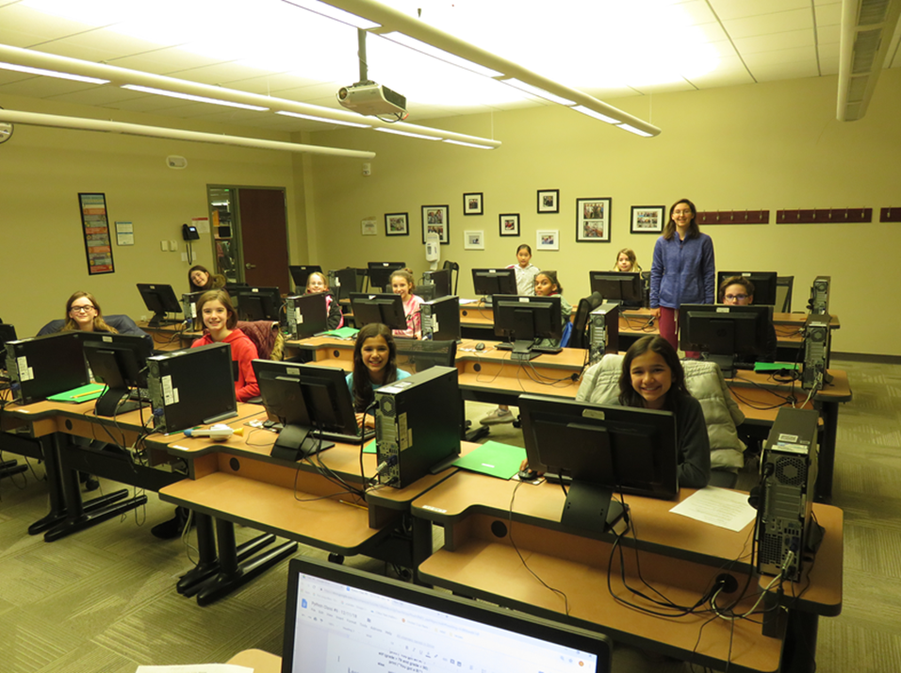
Teaching Experience:
I became an assistant teacher at my public library
Class: Python and Robotics
ex. Robot ex
The class had a nurturing and encouraging environment
Got a grant from NCWIT (National Center for Women & information tech) to teach girls Python
Notes:
My name is Nicole Cheetham and I am a Senior at Shenedehowa High School in upstate New York.
I am currently working with a team from MIT Lincoln Laboratory to create an AI class for students in middle school.
You might be wondering how a high school student is doing this. Let me tell you my story.

Slide 3
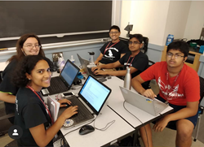
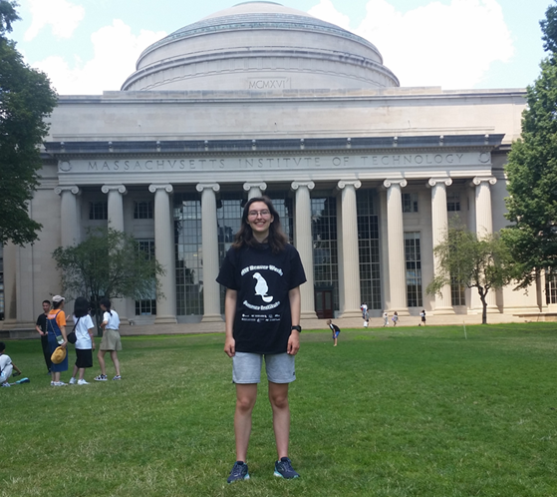
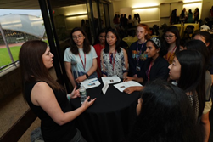
Summer Camp
4 weeks at MIT: July 2019
100 hrs. of pre-work
group projects
Apply knowledge
Supportive community
Encouraged to try their best and improve

Slide 4
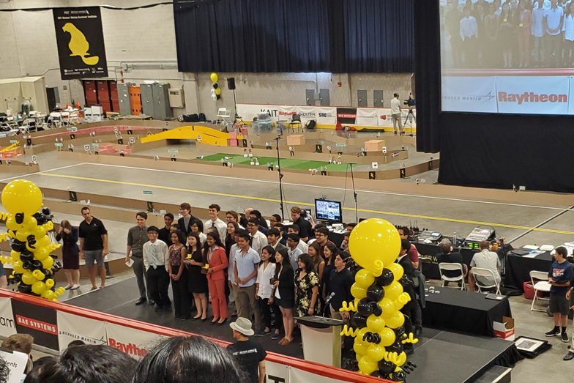
Conclusion:
At the end of the program there was a challenge:
Help expand Beaver Works
AI education is essential
Opportunities are necessary
Engaging and welcoming environment
That is why…

